Slide 1
REDCap: Project Lifecycle
A walkthrough of the milestones in a project's lifecycle, highlighting key features and considerations.
From the University of Colorado REDCap Administrators

Slide 2
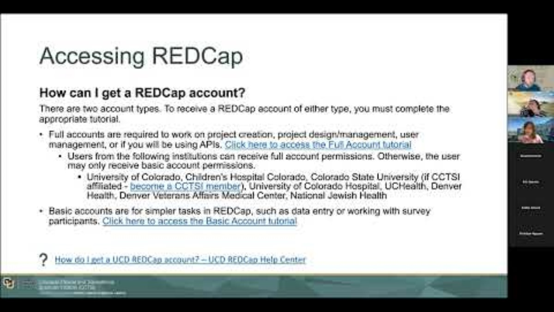
Need a refresh?
Check out our "Introduction to REDCap" presentation from CU Data Week 2025:
Introduction to REDCap - YouTube

Slide 3

Quick links:
What is REDCap? – UCD REDCap Help Center
Who can use REDCap? – UCD REDCap Help Center
How do I get a UCD REDCap account? – UCD REDCap Help Center

Slide 4





Development
Production
Analysis/Cleanup
Completed

Slide 5
Development
Begins when a project is created.
No restrictions on modifications.
TEST DATA ONLY. Do not collect real/live data.
All features are available at this time*, so you should test the project thoroughly.
  *The exceptions to this are features that relate directly to change/version control as those features only become necessary during the production stage.
Why should I move my project to production before I collect live data? – UCD REDCap Help Center

Slide 6
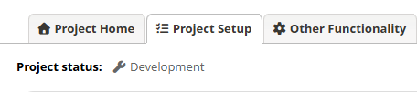
How do I know if my project is in dev?
This is the "My Projects" page. Which project do you think is in development mode?
A.
B.

Slide 7
Development
Feature Highlights

Slide 8
User Rights
Dictates permitted behavior for a user
Different permissions allowable for full/basic accounts
Recommend applying Principle of Least Privilege
Custom Rights
User Roles allow for standard permission sets
User Expiration
How do I add users to my project? – UCD REDCap Help Center
What rights and permissions can users be granted? – UCD REDCap Help Center

Slide 9
Randomization
Requires the support of a statistician to establish
Two allocation tables required – dev and prod
Cannot be changed, only appended in production
Multiple customization options for strata and triggers

Slide 10
Multi-Language Management
Translate existing fields into other languages
  Prevents duplication of data points that need to be merged later, resulting in cleaner datasets.
Step 1: Configuring basic system settings
  Set a base language
  Add additional languages
Step 2: Implementing language selection
Step 3: Formatting translations
Language 🌐 – UCD REDCap Help Center

Slide 11
Move to Production
Should occur before...
  You collect any live/real data in your project
Should occur after...
  You have fully designed your project
  You have thoroughly tested your project (including data entry forms, survey distribution, and survey submission)
Consists of 4 steps
  Submit a move to production request (Project Setup page)
  Review feedback from REDCap Administrators (if any is provided)
  Complete a final review of your project for any validation or identifiers
  Complete the form sent to you from REDCap Administrators
What should I do before I move my project to production? – UCD REDCap Help Center
How do I move my project to production? – UCD REDCap Help Center

Slide 12
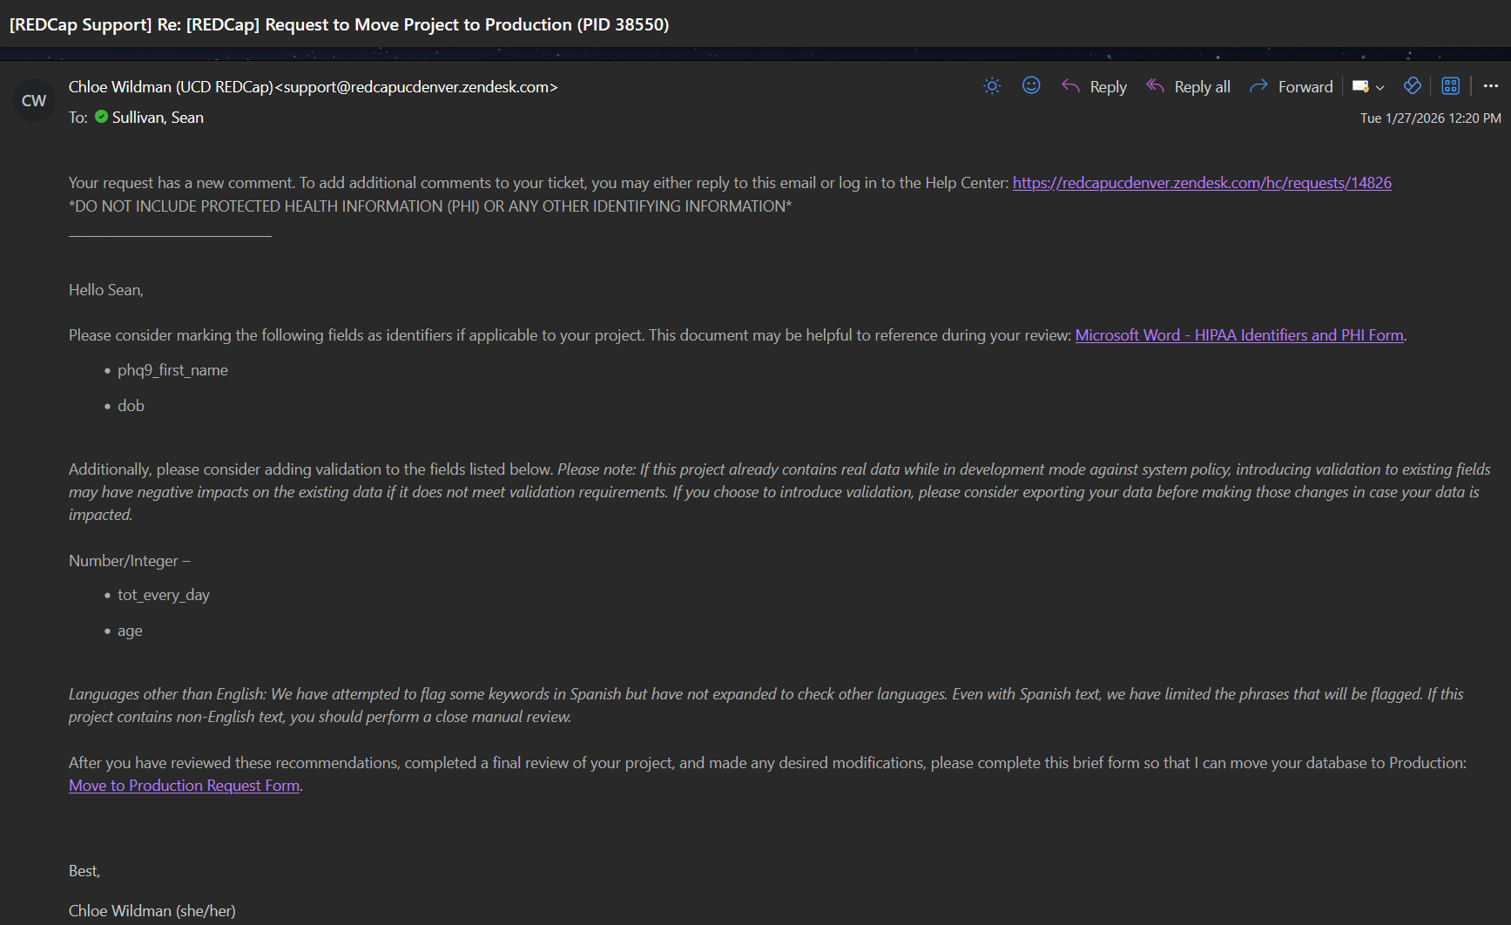
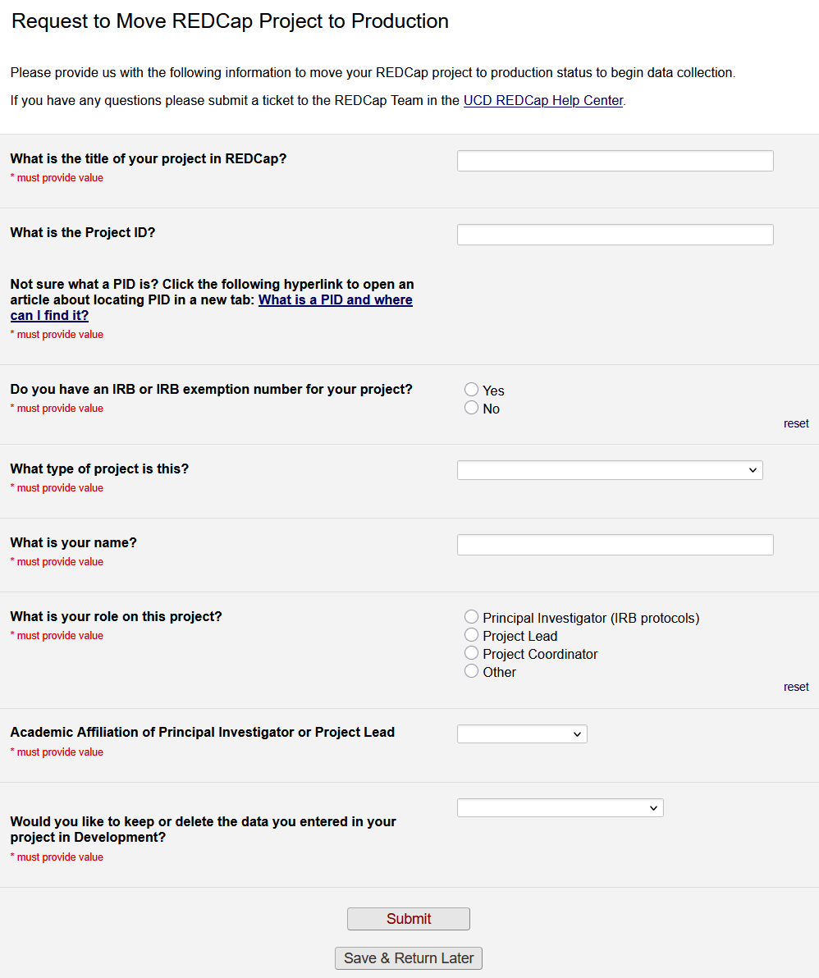
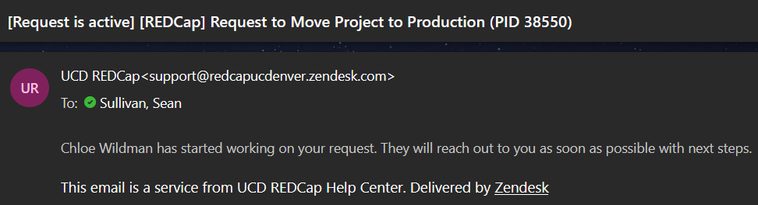
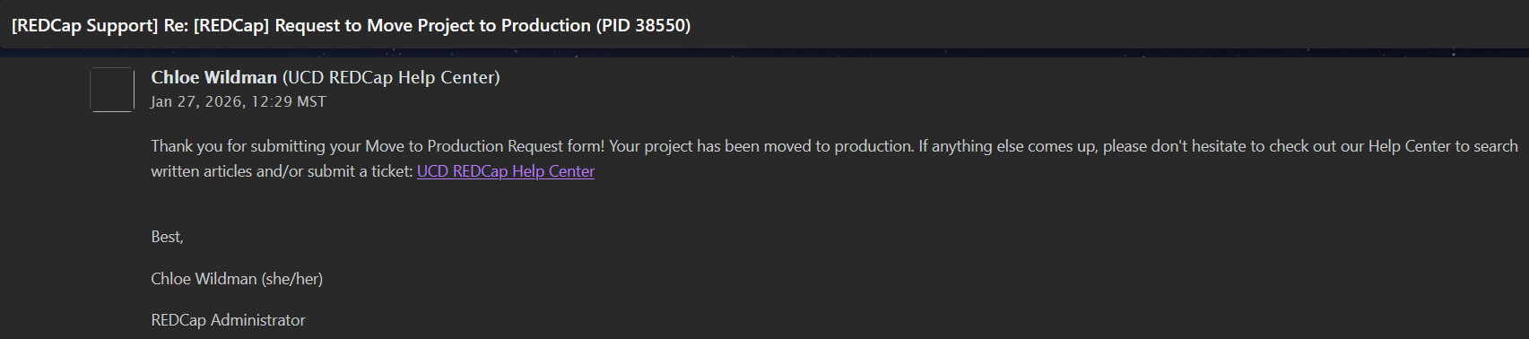
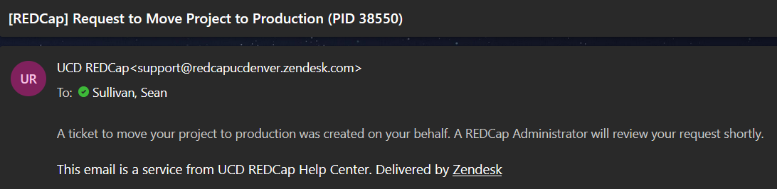

Slide 13

Development
Production
Analysis/Cleanup
Completed

Slide 14

Production
While collecting live/real data.
Imposes restrictions on what modifications can be made to a project, and how, to help prevent:
  Unexpected data loss
  Degradation or loss of data quality/integrity

Slide 15
Production
Feature Highlights

Slide 16
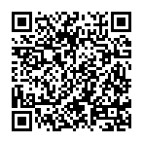
Survey Distribution Example
Live demo!
https://redcap.ucdenver.edu/surveys/?s=43M9XWPJTNXWTYNY

Slide 17
Modifications While in Production
Design changes to instruments are not live automatically
  Changes are drafted in "Draft Mode" (including MLM changes)
  You should then review and submit those changes
  Your surveys are not interrupted, even if your changes go to the Administrator team for review
Draft Preview Mode
Important notes
  Not all changes are subject to "Draft Mode" -- for example, survey settings
  The system only flags changes that are potentially critical at the time of committing the change
    It does not track branching logic changes and whether that could eventually result in the erasure of data, so make these changes carefully
How do I make changes while my project is in production? – UCD REDCap Help Center
How can I review my drafted changes while my project is in production? – UCD REDCap Help Center

Slide 18

Development
Production
Analysis/Cleanup
Completed

Slide 19

Analysis/Cleanup
When data collection is complete, but the project is still being regularly accessed for data quality cleanup and/or analysis.
Prevents edits to project design and settings.
Prevents survey submissions.
Choose whether to permit staff to update records.

Slide 20


Development
Production
Analysis/Cleanup
Completed

Slide 21

Completed
Retains your data.
Prevents future access and manipulation of the project.
Hides the project from all users project list unless "Show Completed Projects" is selected.
Can be restored by a REDCap Administrator if needed.

Slide 22

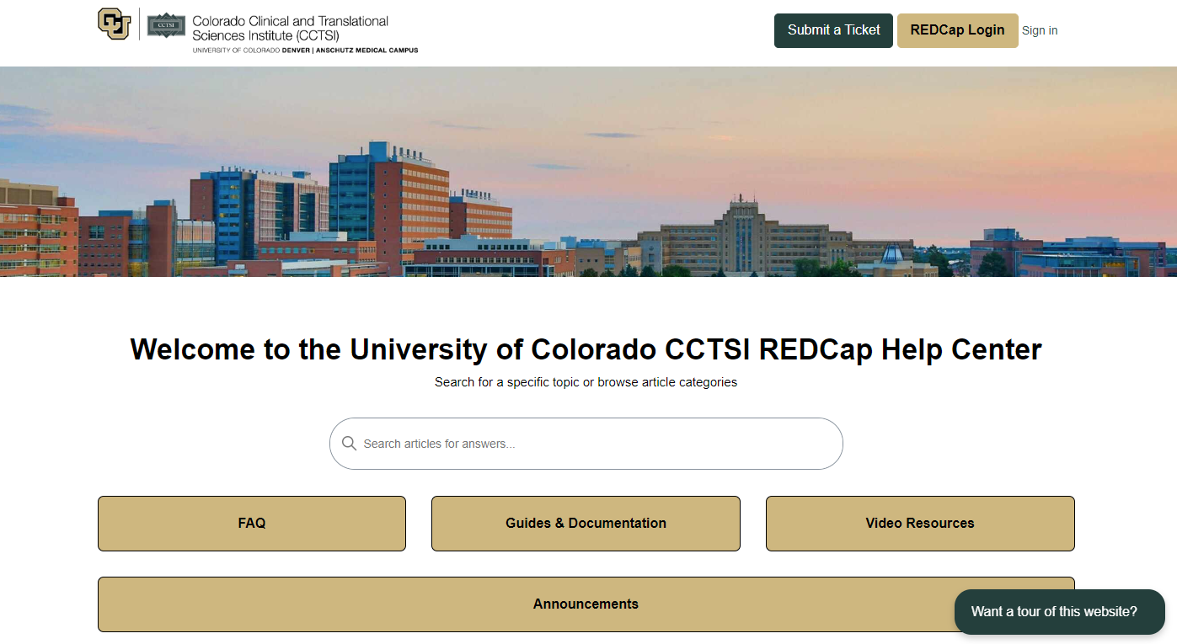
Need help?
Explore articles or contact the team by submitting a ticket
UCD REDCap Help Center (https://redcapucdenver.zendesk.com/hc/en-us)

Slide 23
Complete the attendance link in the chat!

